Slide 1
Logo
if any
Project Title
First Author 1¹, Author 2², Author 3¹, Author 4¹
¹ Affiliation Details, ² Affiliation Details
QR CODE
To Online submission
Poster ID: ###
Acknowledgement.
Contact Information

Slide 2
Logo
if any
Project Title
First Author 1¹, Author 2², Author 3¹, Author 4¹
¹ Affiliation Details, ² Affiliation Details
QR CODE
To Online submission
Poster ID: ###
SECTION NAME
SECTION NAME
SECTION NAME
SECTION NAME
Acknowledgement.
Contact Information

Slide 3
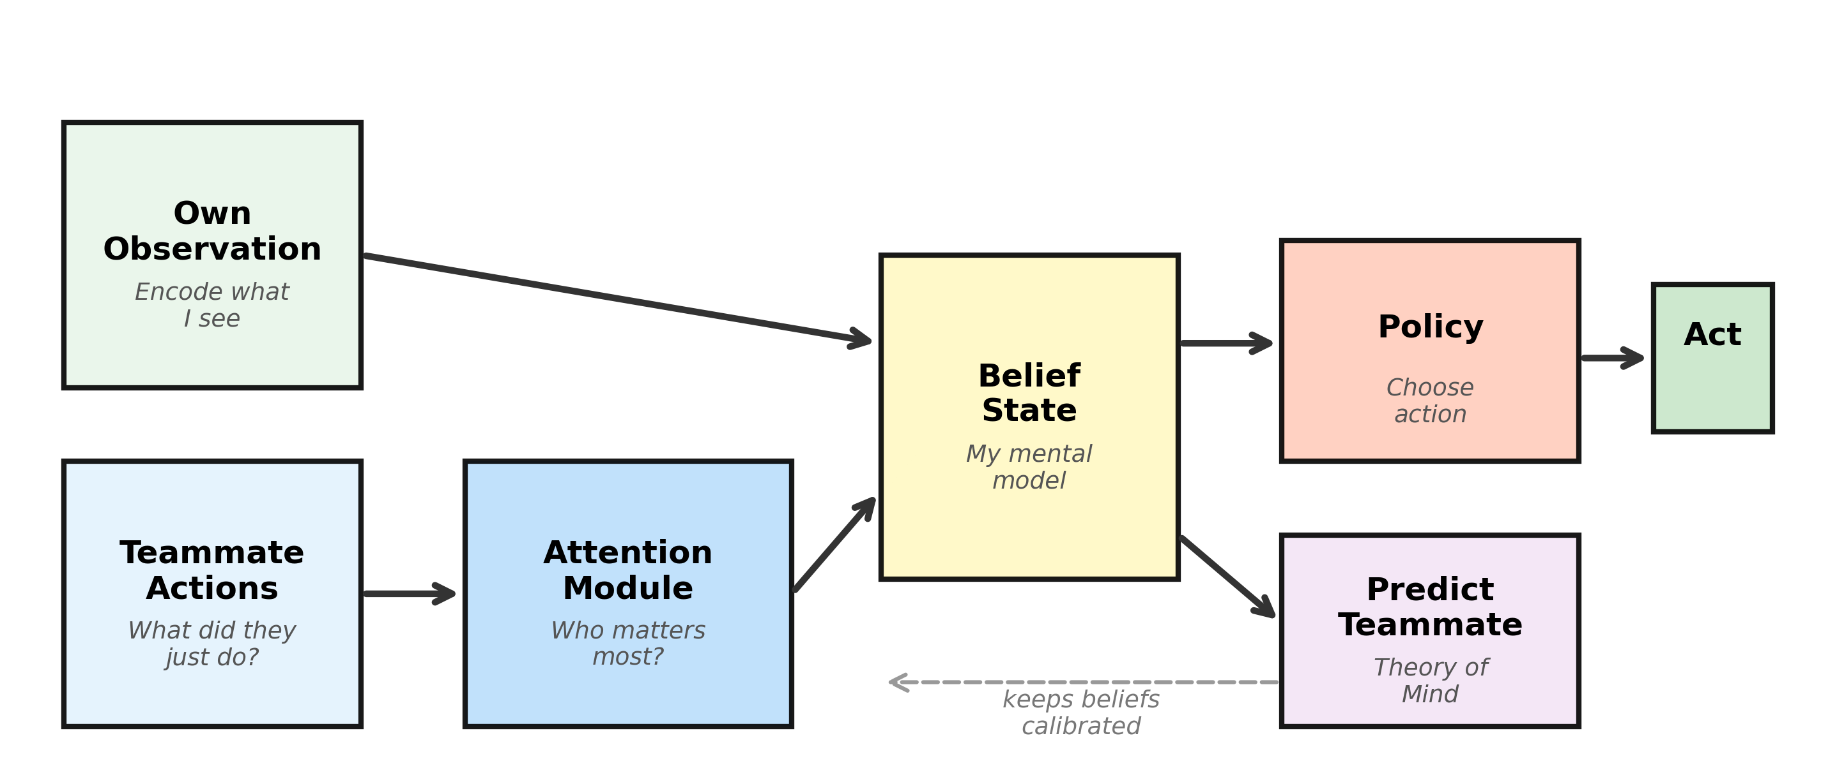
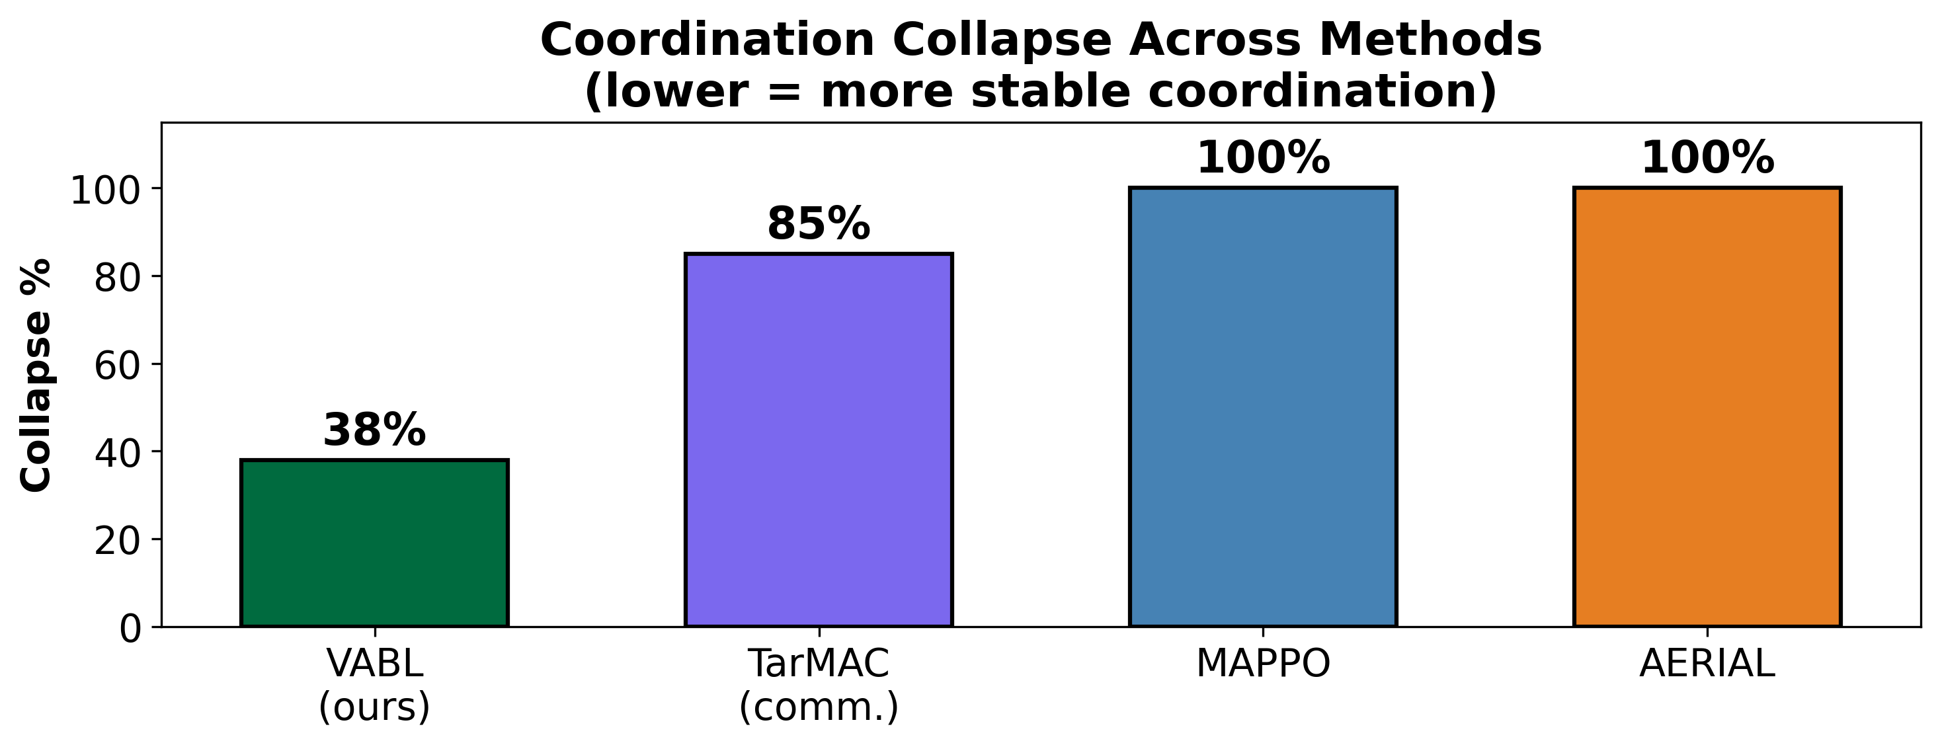
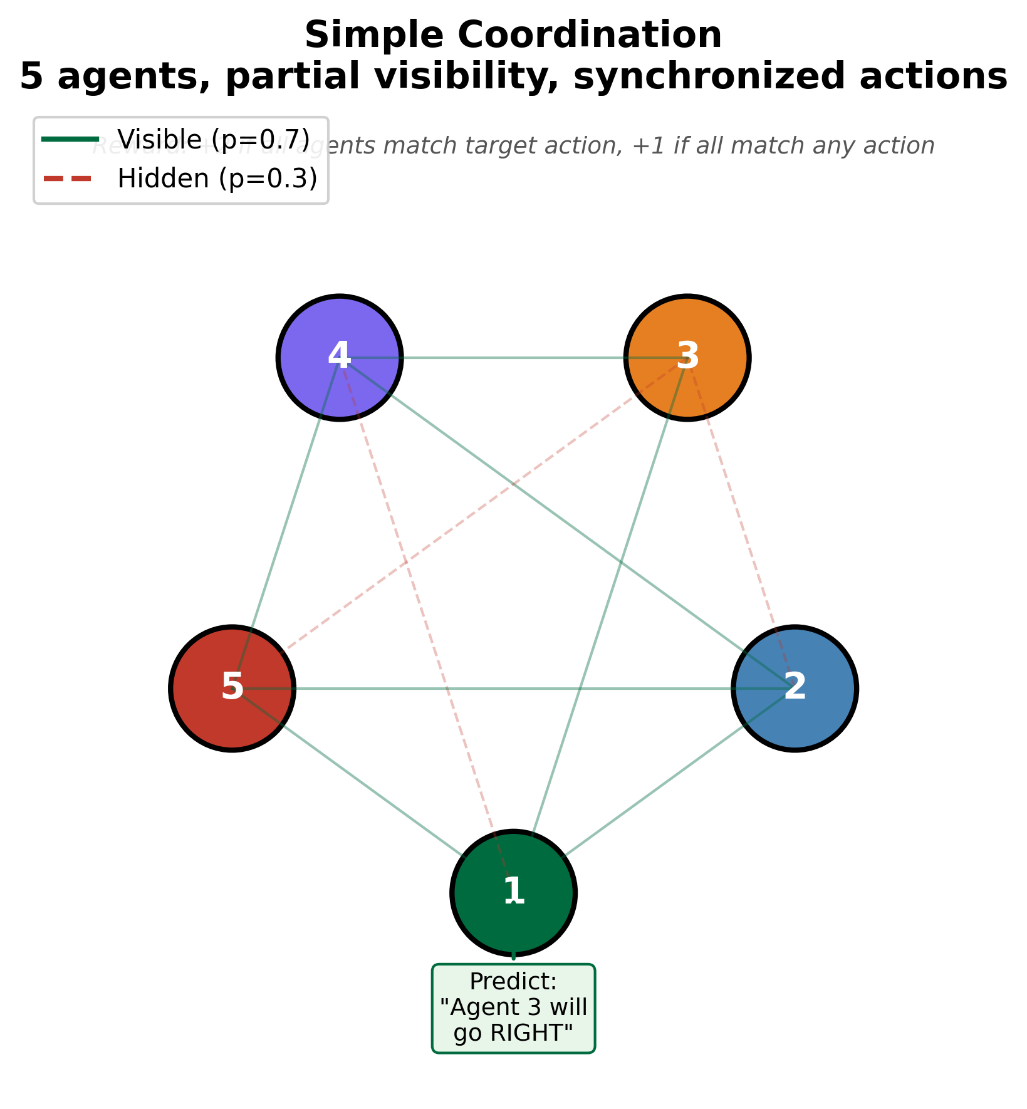
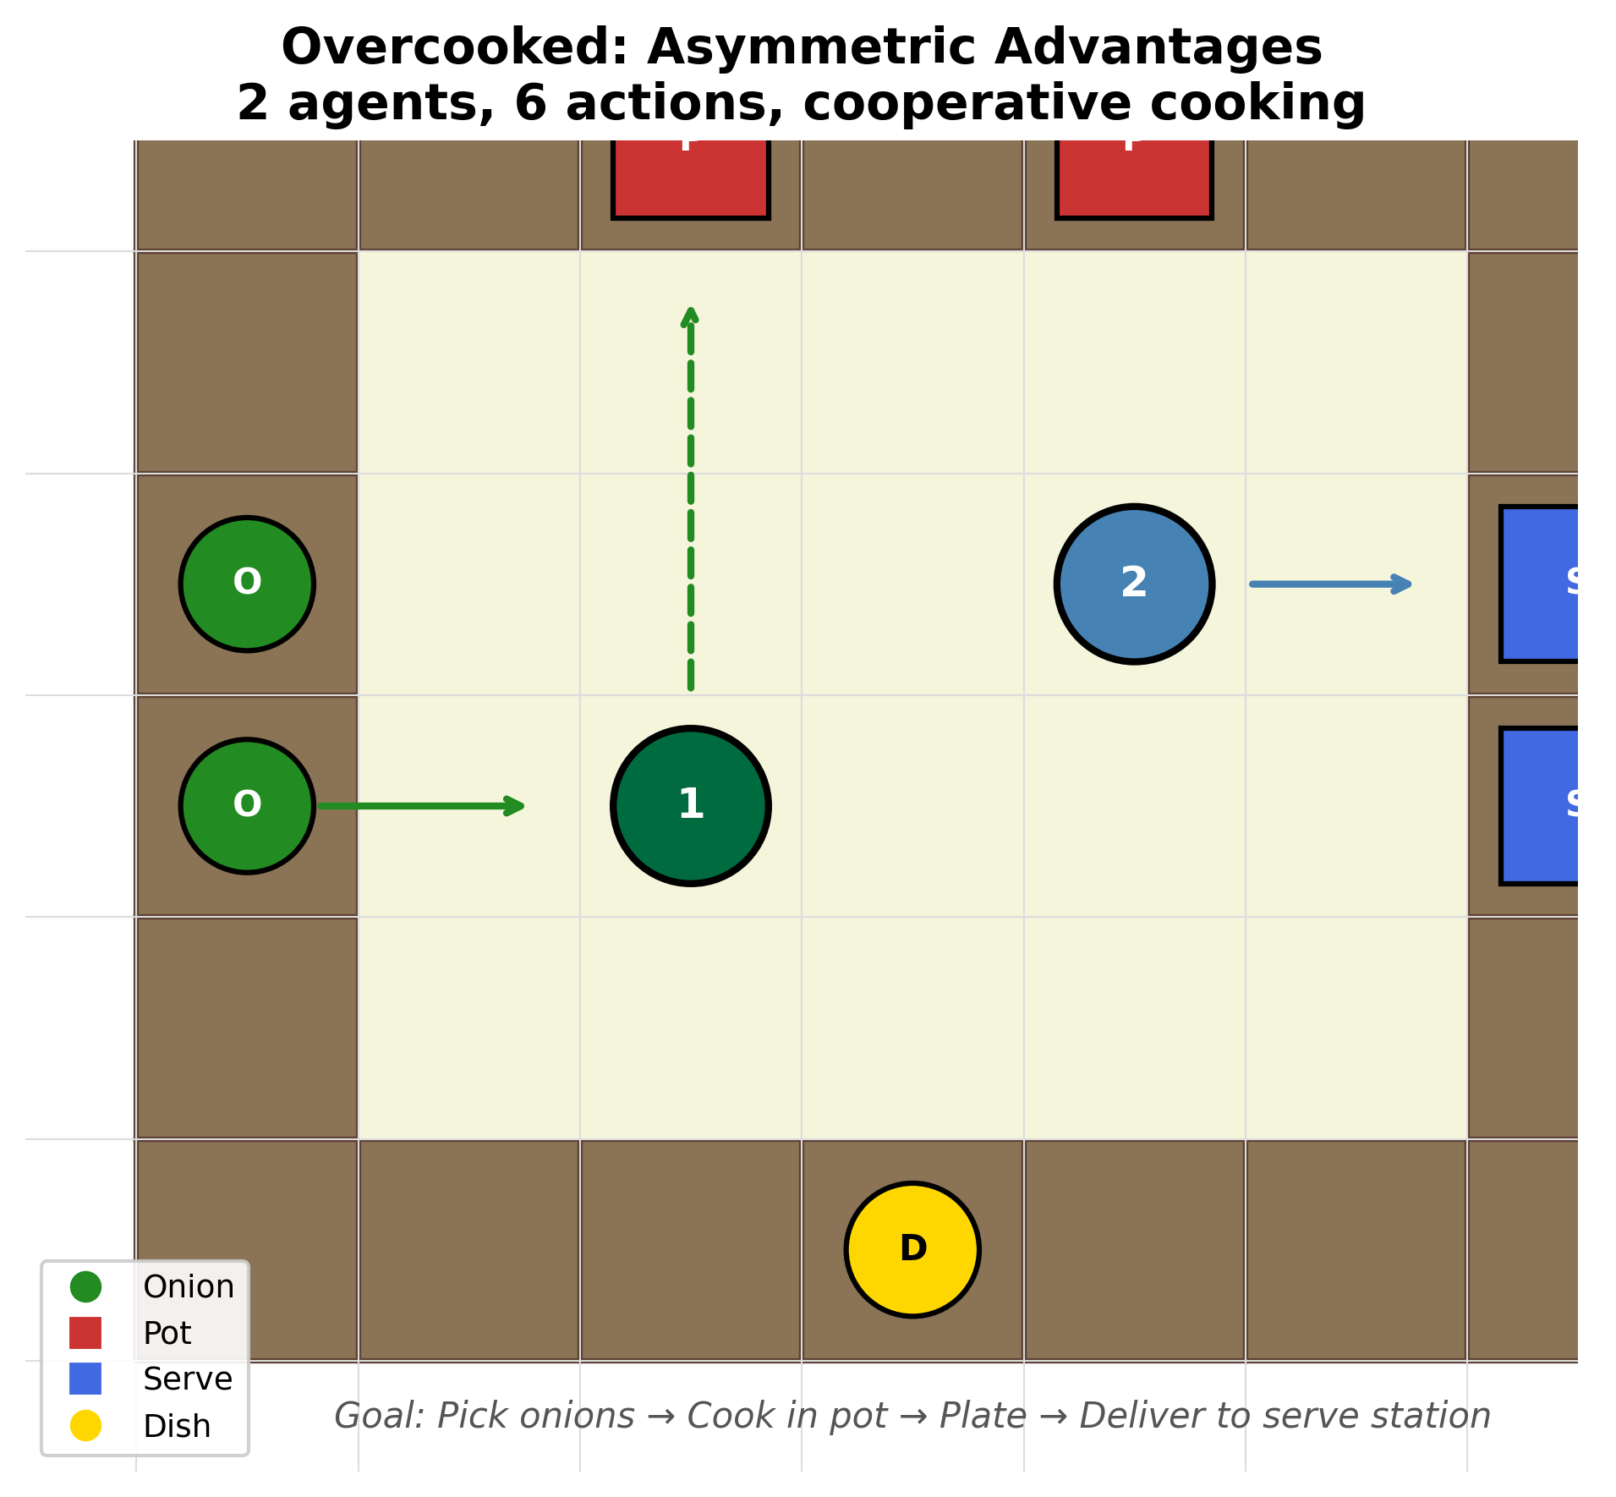
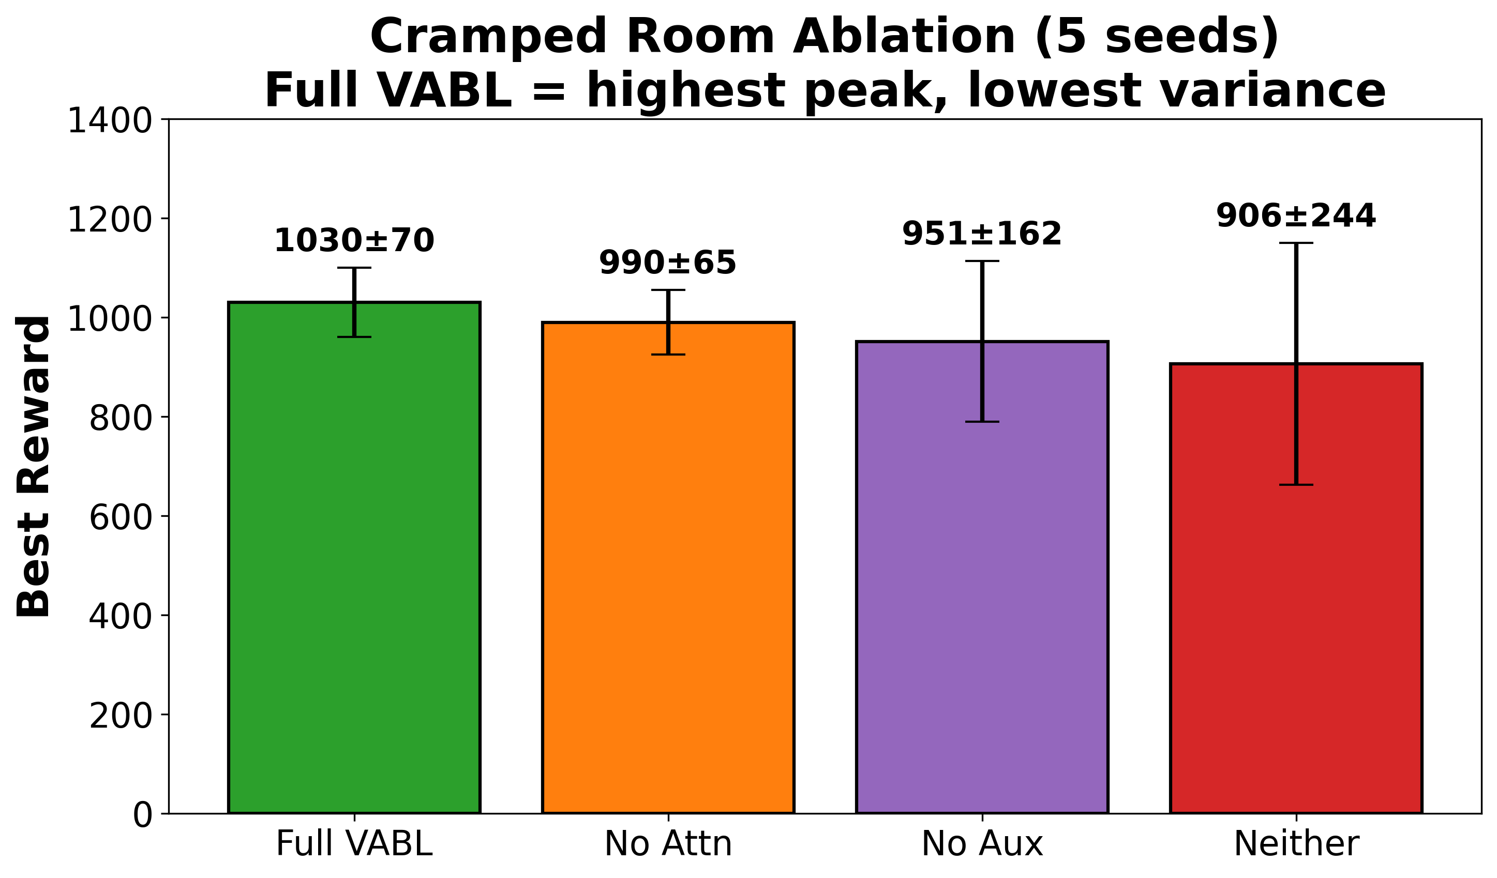


Logo
if any
VABL: Attention-Based Belief Learning for Implicit Multi-Agent Coordination
Vishnu Kadiyala¹, Mohammed Atiquzzaman¹
¹ School of Computer Science, University of Oklahoma
QR CODE
To Online submission
Poster ID: GR30
The Problem
VABL
Can AI agents coordinate without communication?
A quarterback reads the safety, sees his receiver break, and throws there’s no audible exchange needed. He coordinates by predicting, not communicating
Setting: Decentralized POMDPs
(agents act on partial observations, no shared communication channel)
Coordination Collapse
Agents learn teamwork then catastrophically forget it.
Observe: Watch teammates’ actions
Attend: Multi-head attention (h=4) weights which teammates matter. Q = belief. K/V = action encodings
Update: GRU updates belief state: $b_{t}^{i}=\text{GRU}\left(\left[φ\left(x_{t}^{i}\right) | c_{t}^{i}\right], b_{t−1}^{i}\right) w$here, $c_{t}^{i}=\sum_{j}{α_{ij}}⋅ψ\left(a_{t−1}^{j}\right)$
Predict: Auxiliary loss predicts teammates’ next actions (Theory of Mind), keeps belief calibrated.
$$L= L_{PPO}+ λ \sum{CE^{π}\left(⋅\right|b_{t}^{i}), a_{t+1}^{j}}$$
Prediction accuracy: 17% (chance) → 86%
CTDE paradigm: centralized critic (training),
decentralized actors (execution)
Overhead: <10% vs MAPPO, ~1.3× parameters
Environments
Results
Conclusion and Impact
Key Insight
Every method discovers coordination.
The challenge is keeping it.
VABL’s auxiliary prediction loss prevents belief drift, sustaining coordination without any communication channel.
Data Science Contributions
• Behavioral prediction from sequential observational data (86% accuracy)
• Self-supervised regularization prevents catastrophic forgetting (2.3× variance ↓)
• Rigorous evaluation: 5 seeds, 4 baselines, 3 environments, 10M-step extended runs.
Applications
• Warehouse robot fleets
• Autonomous vehicle coordination
• Disaster response drone swarms
Future Work
• Hanabi evaluation: partial observability where agents cannot see their own cards.
• Scaling to large teams (N>10): sparse attention and hierarchical grouping to reduce quadratic cost.
• Hybrid communication: combine implicit behavioral inference with selective explicit messaging, using
communication only when prediction confidence is low
Summary of Key Results (5 seeds, 95% CIs)
• Overcooked: 3.3× higher reward than MAPPO
• 38% collapse vs 100% (MAPPO, AERIAL)
• TarMAC (comm.): Final 56.6 but 88% collapse
• 5-agent: VABL 95.7±3.3 vs MAPPO 84.0±10.4
• 10M steps: MAPPO collapses to zero reward
Cramped Room ablation shows:
Full VABL = highest peak (1030±70), lowest variance.
Simple Coordination - 3-5 agents must synchronize actions under stochastic partial visibility (p=0.7). Reward for matching the target action. Tests selective attention with multiple teammates.
Overcooked-AI - 2 agents cooperate in a kitchen: pick onions, cook soup, plate, and deliver. Requires implicit role
assignment (who gets ingredients vs who delivers). 6 actions, horizon 400 steps.
Both environments test coordination without communication channels.
. This work was supported by the School of Computer Science at the University of Oklahoma. We thank the Data Institute for Societal Challenge (DISC) for fostering interdisciplinary data science research.
vishnupk@ou.edu

Slide 4
Logo
if any
Project Title
First Author 1¹, Author 2², Author 3¹, Author 4¹
¹ Affiliation Details, ² Affiliation Details
QR CODE
To Online submission
Poster ID: ###
SECTION NAME
SECTION NAME
SECTION NAME
SECTION NAME
SECTION NAME
Acknowledgement.
Contact Information

Slide 5
Logo
if any
Project Title
First Author 1¹, Author 2², Author 3¹, Author 4¹
¹ Affiliation Details, ² Affiliation Details
QR CODE
To Online submission
Poster ID: ###
SECTION NAME
SECTION NAME
SECTION NAME
SECTION NAME
SECTION NAME
Acknowledgement.
Contact Information

